Slide 1
Weed Count Overview ACRES | Summer 2022
VARUN AGGARWAL
Project Supervisors:
Dr. Dharmendra Saraswat | Dr. Bryan YouNG

Slide 2
Detection Images

Slide 3
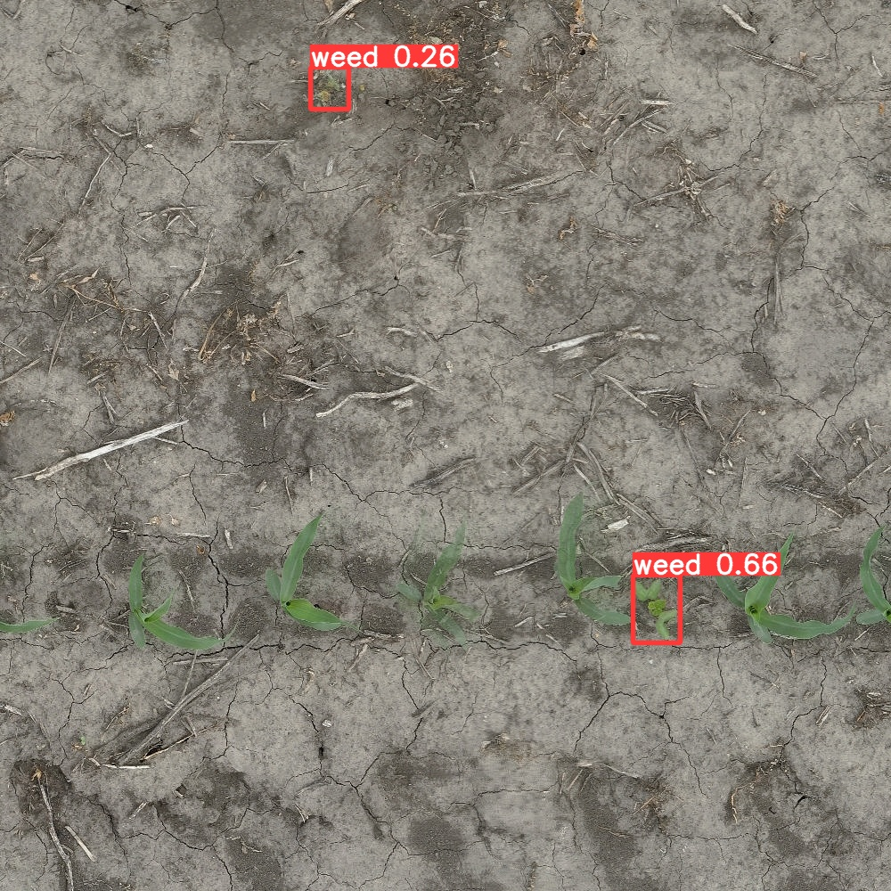
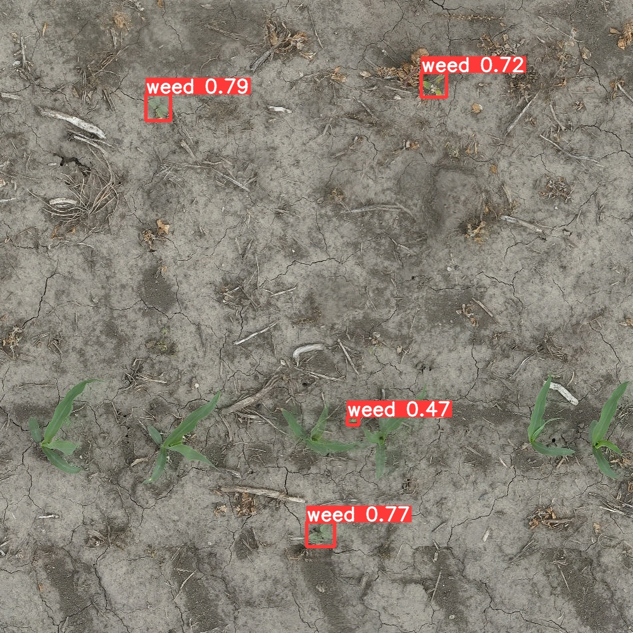
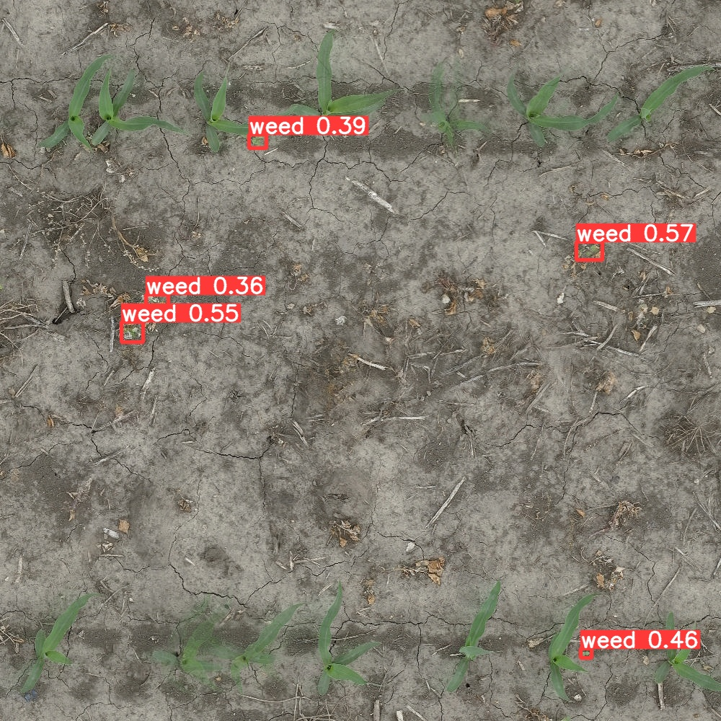
In-row weed detection

Slide 4
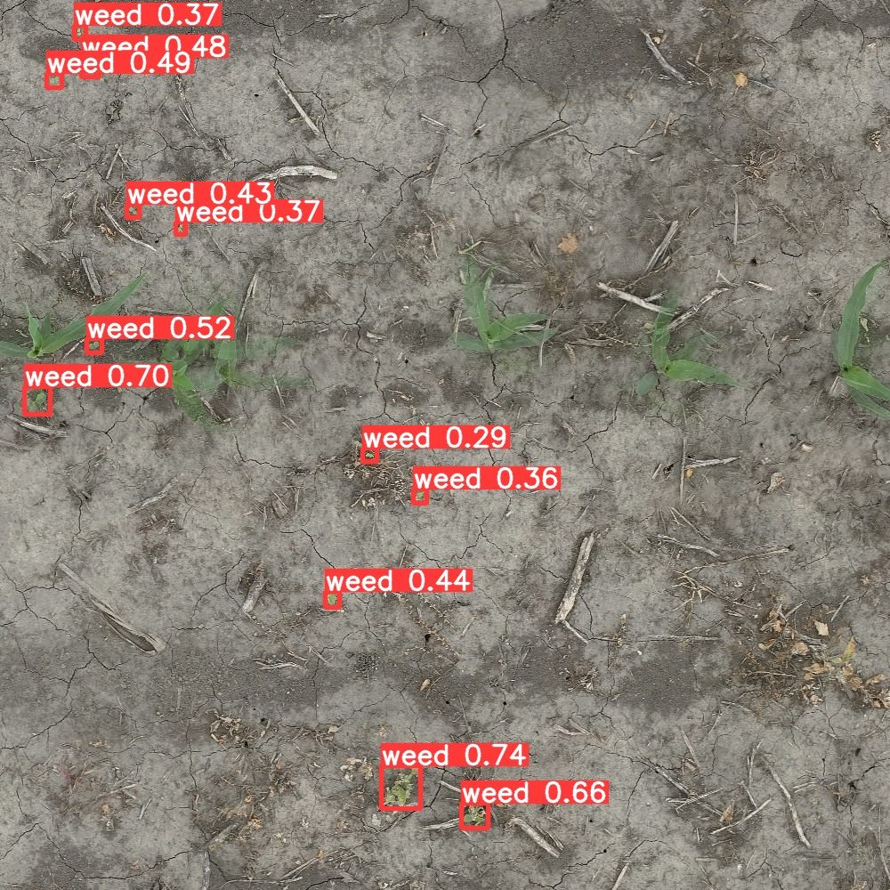
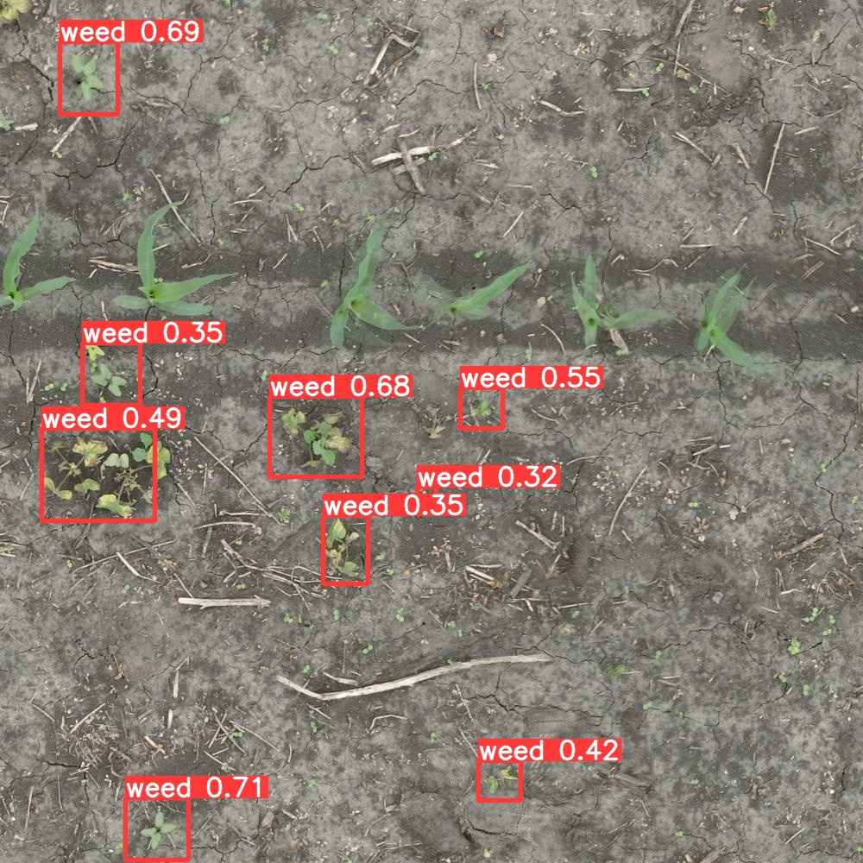
Detection in varying weed size

Slide 5
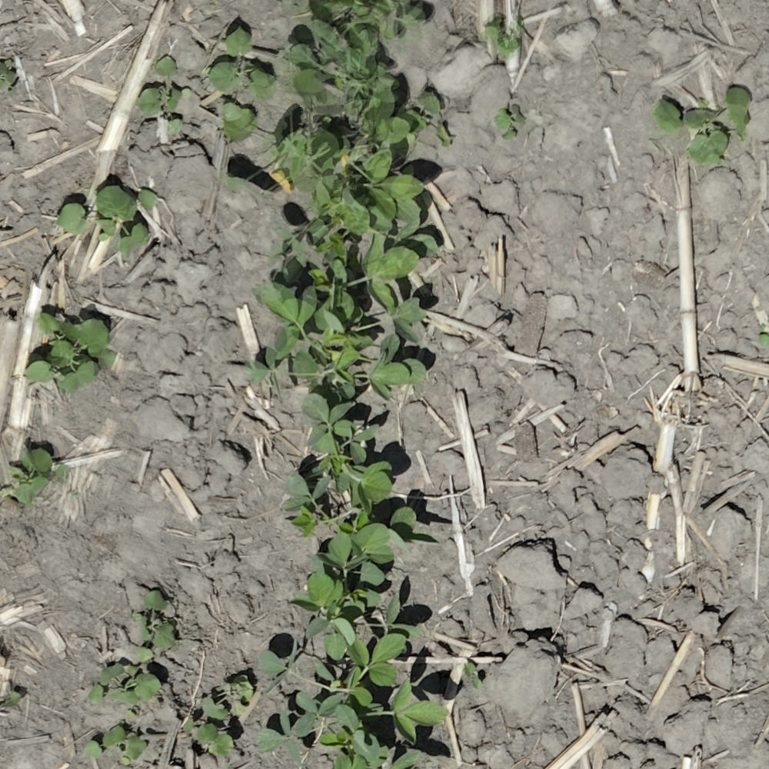
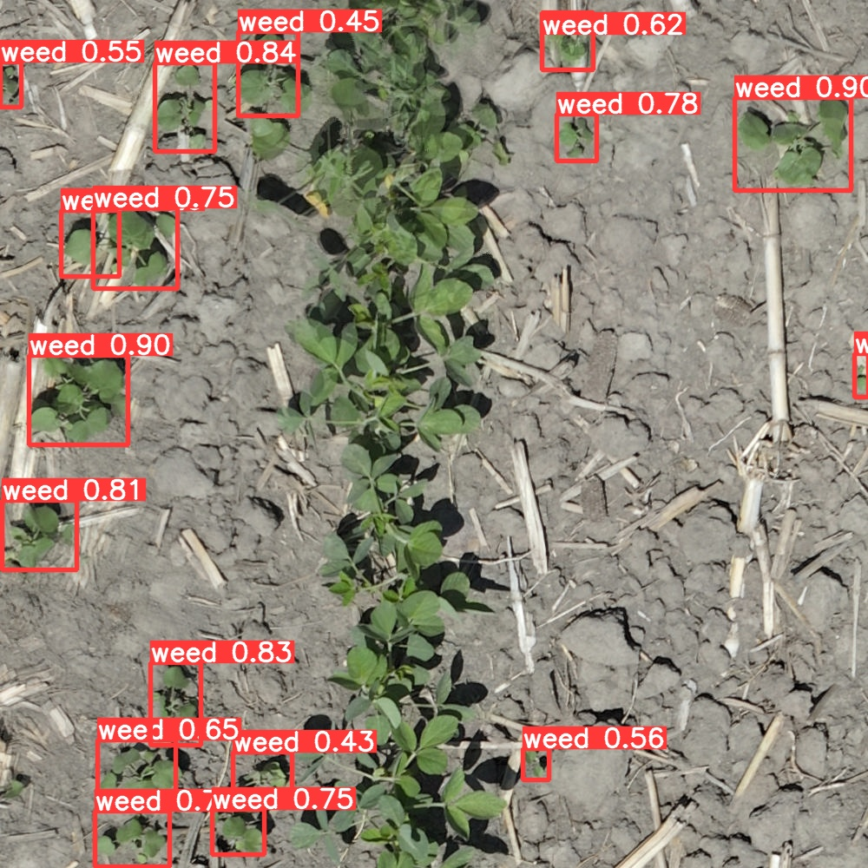
High Density Areas in Soy
17 Weed instances

Slide 6
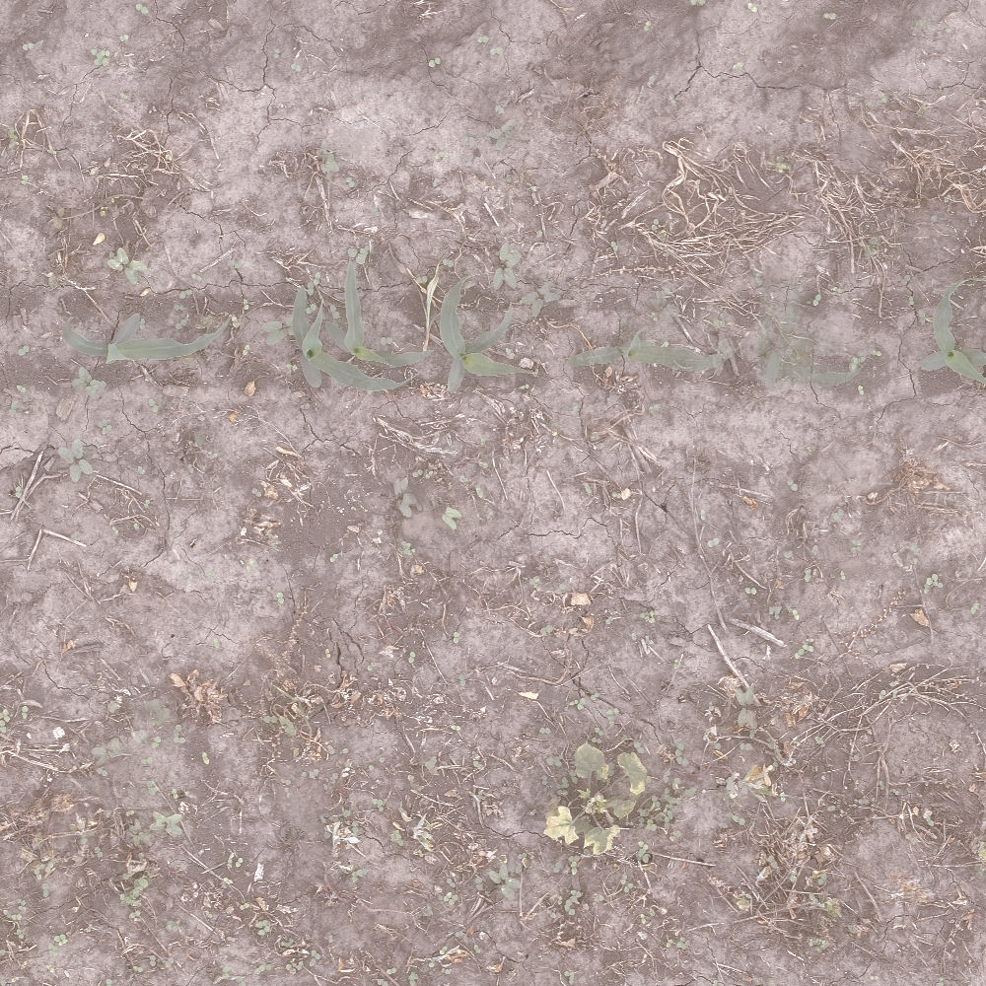
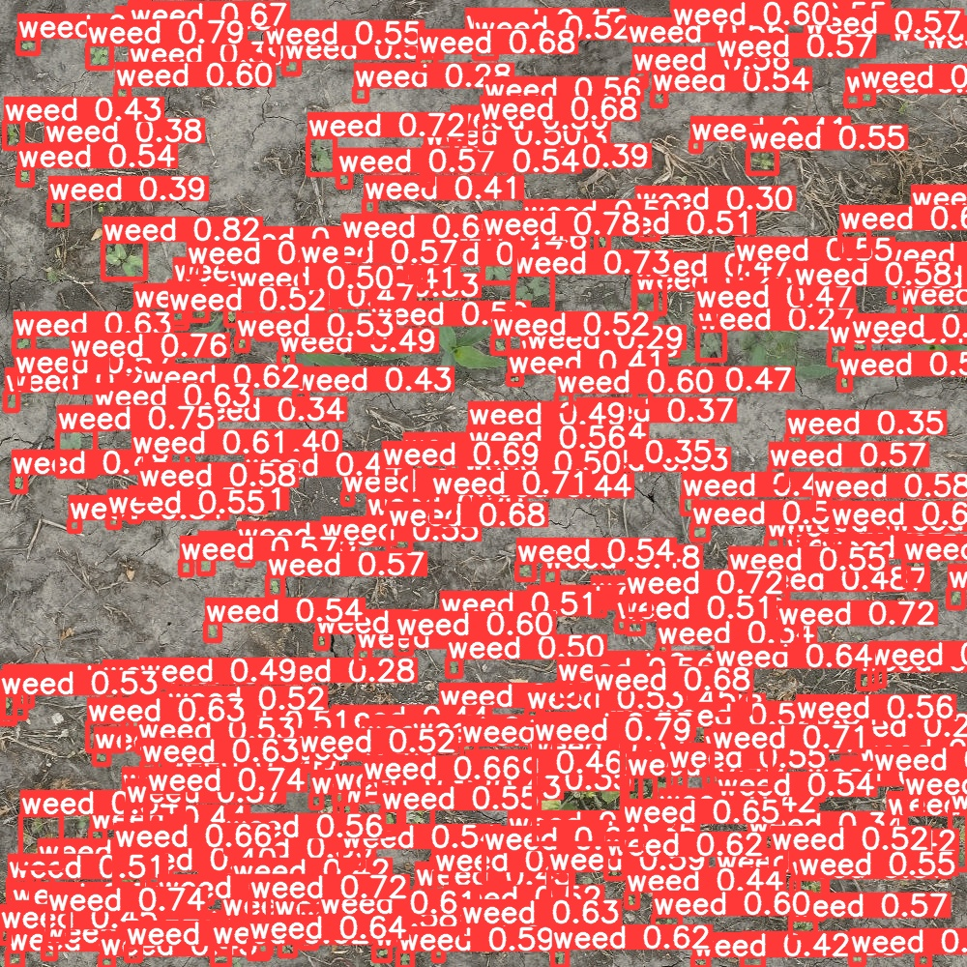
High Density Areas in Corn
204 Weed instances

Slide 7
False Positives and Negatives

Slide 8
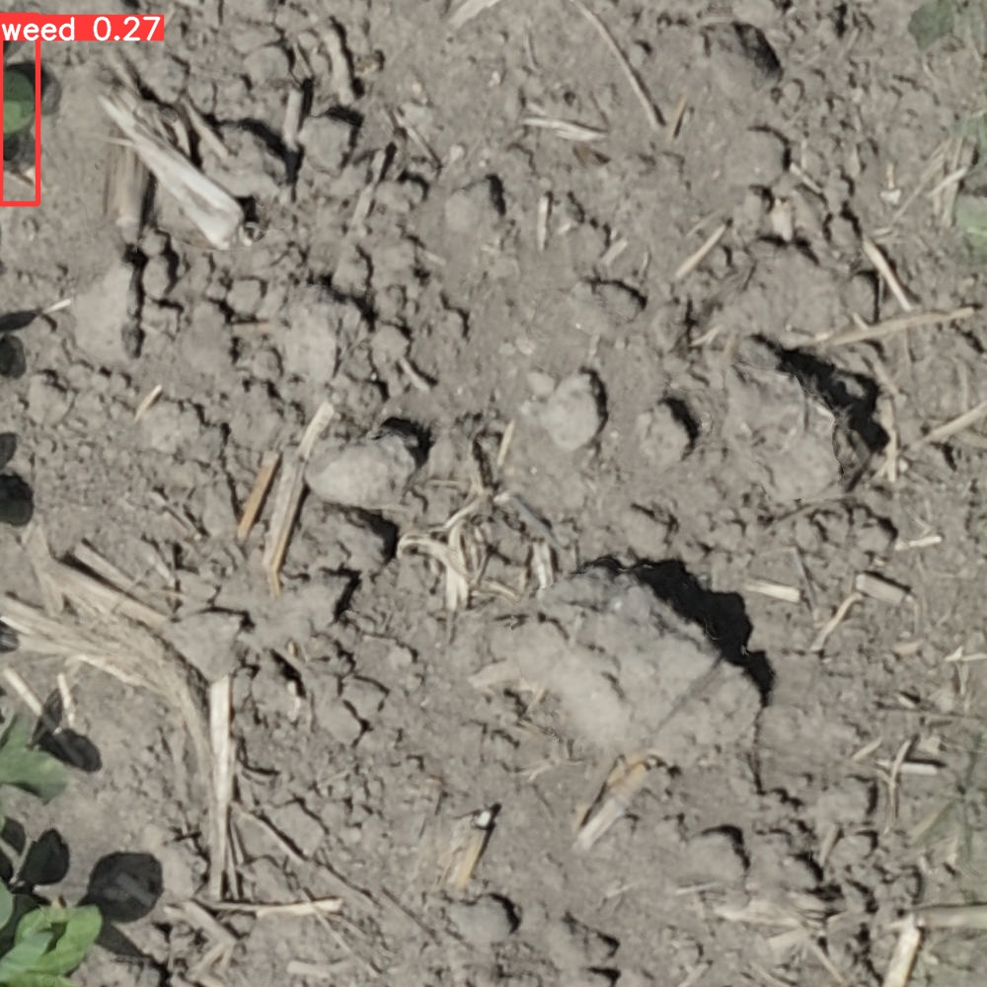
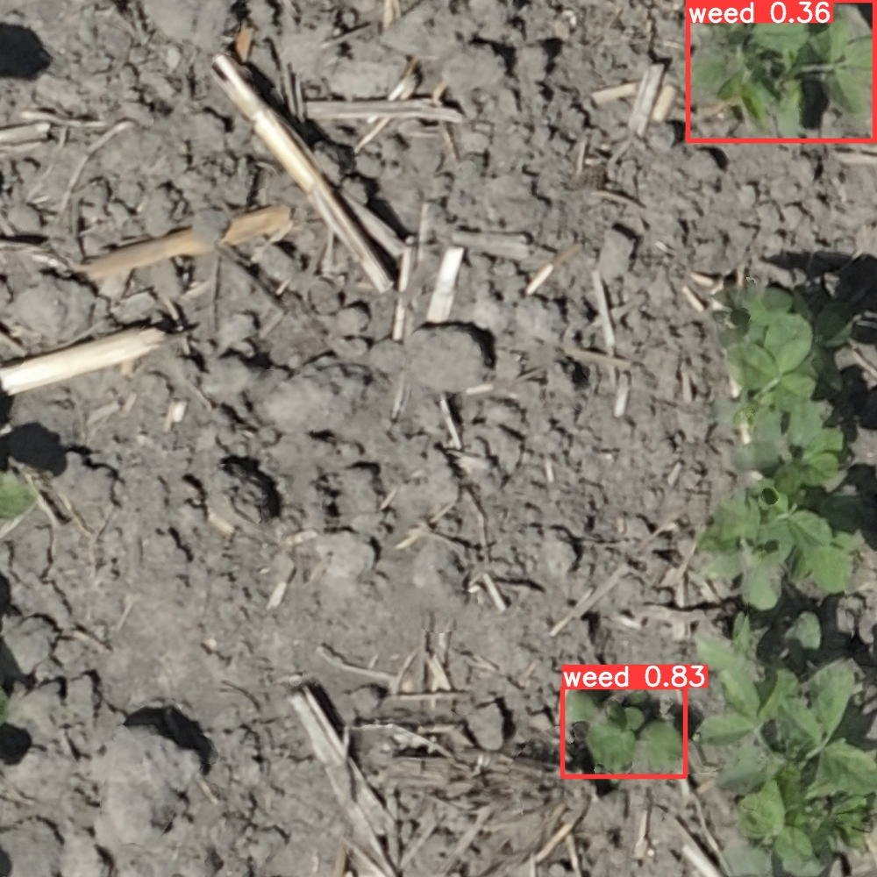

Slide 9
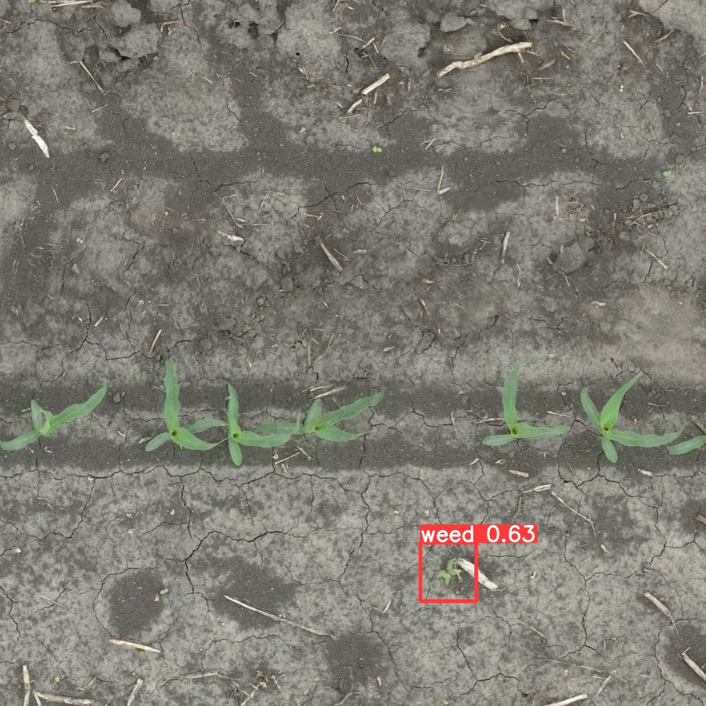
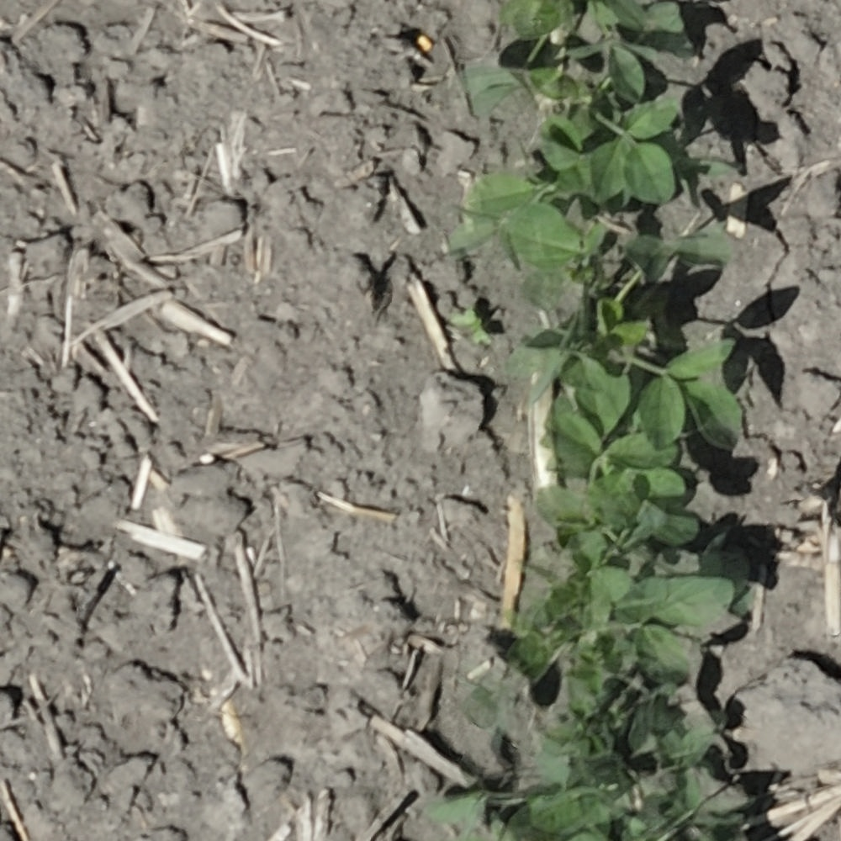

Slide 10
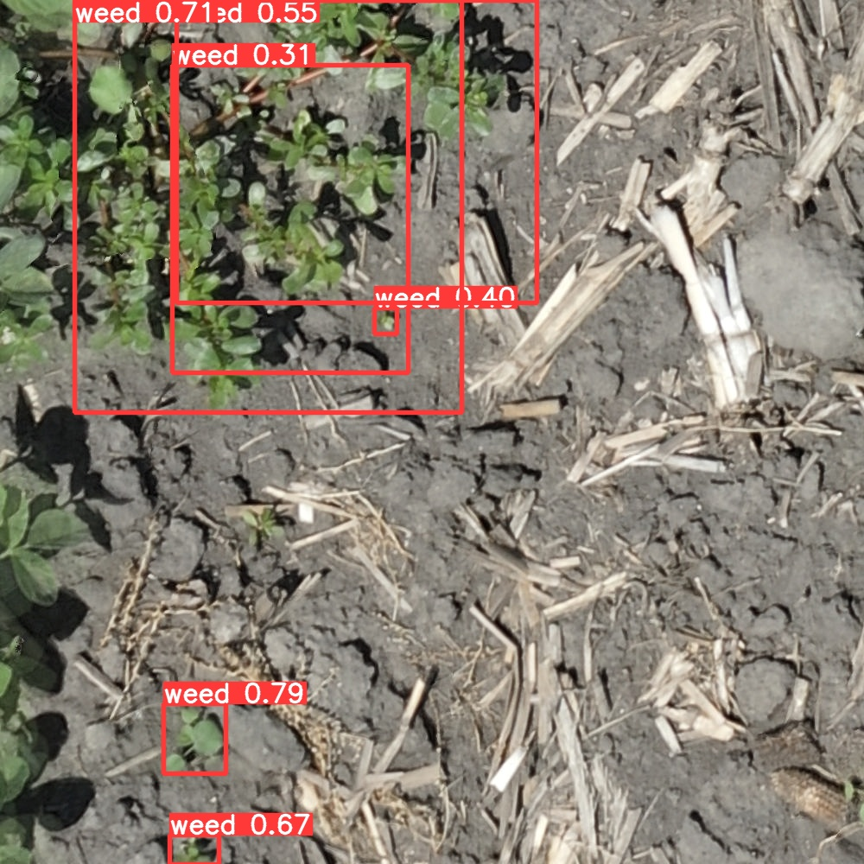

Slide 11
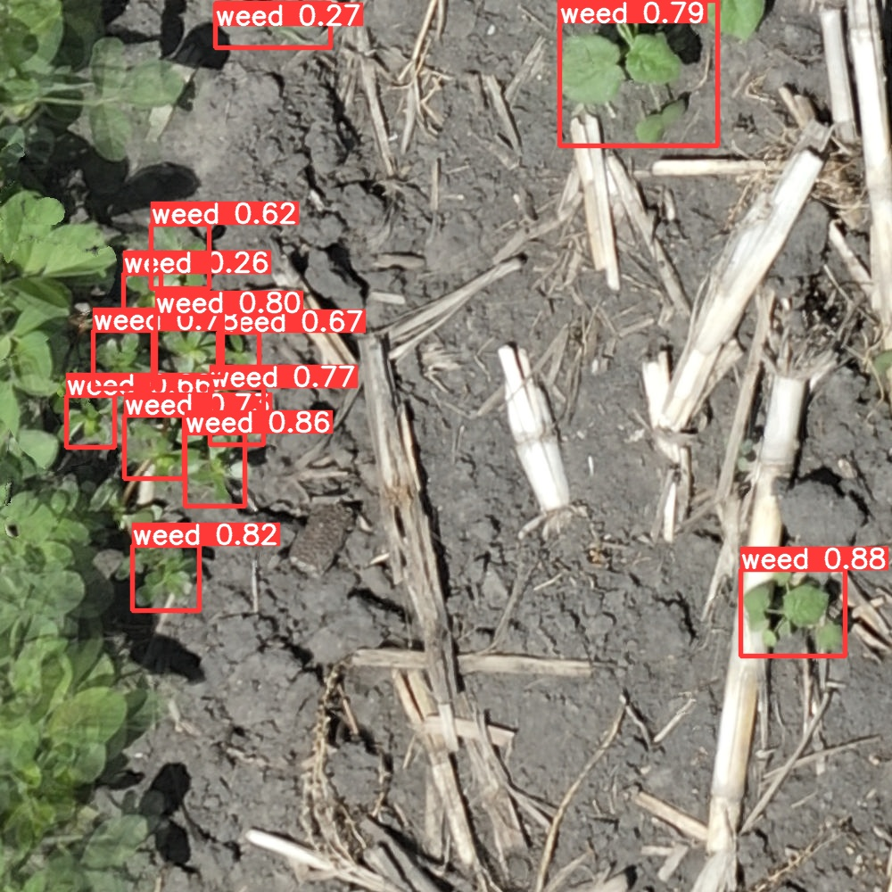
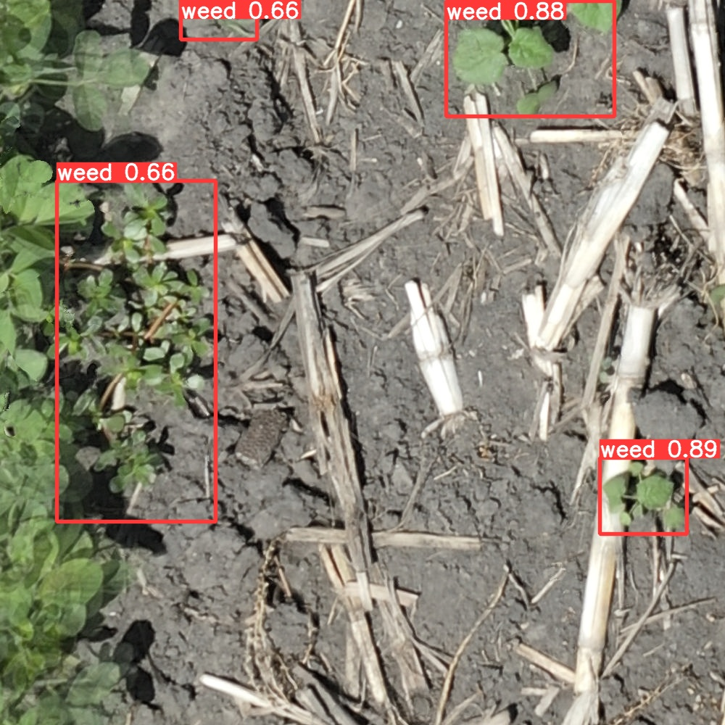
Analyzing and Fixing Issues
Before
After

Slide 12
Manual count vs Annotation count vs Deep Learning count
Notes:
Manual count vs Annoation count vs deep learning count images – count diff – flwo hcart – quantitive

Slide 13
Manual vs Annotation vs Deep Learning Count
In high weed density area, DL Model count could be more reliable than manual count
Soy Plot 105
Manual Count = 89
Annotation Count = 298
DL Model Count = 301
Error = 1.00 %
Corn Plot 110
Manual Count = 369
Aerial Count = 359
DL Model Count = 356
Error = 0.83 %

Slide 14
Process Overview
Notes:
Manual count vs Annoation count vs deep learning count images – count diff – flwo hcart – quantitive

Slide 15
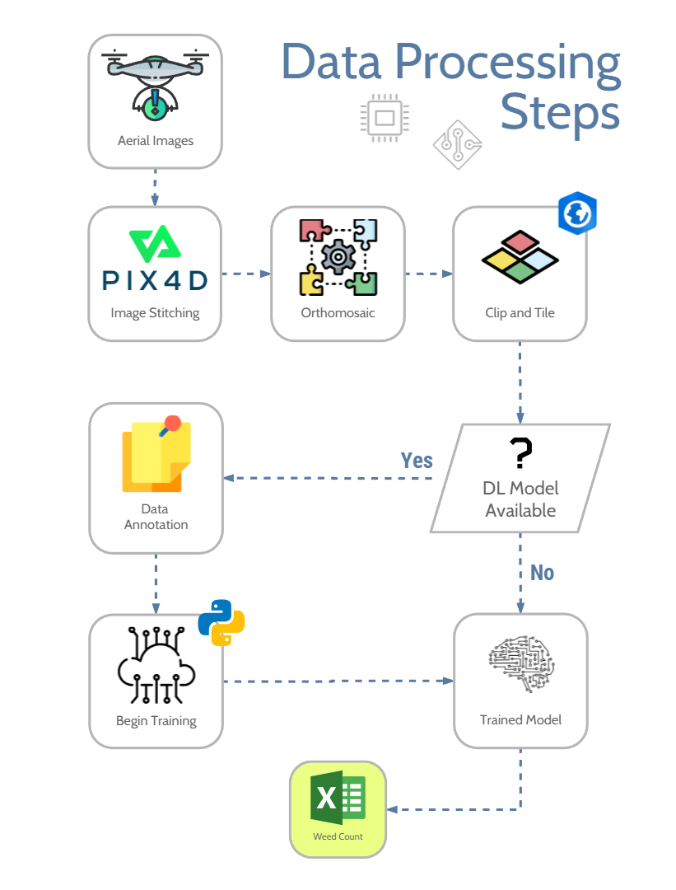
Deep Learning Training
Ensure unbiased training data
Growth Stage Bias
Weed Size Bias
Weed Species Bias
Setting right training parameters
Validating weed labeling

Slide 16
Data Overview
Weed Species | Corn | Soy
IPOSS = Morning Glory spp. | X | X
CHEAL = Common Lambsquarters | X | X
SIDSP = Prickly Sida | X | X
ABUTH = Velvetleaf | X | X
SETFA = Gaint Foxtail |  | X
ERICA = Horseweed | X
RANAB = Smallflower buttercup | X
SICAN = Burcucumber | X
CYPES = Yellow nutsedge | X
POROL = Common purslane |  | X
UAS flights at 3 and 4.5 m
Corn in V2/3 and V5/6 Growth Stage
Soy in VC and V2 growth stage
Three DL Models

Slide 17
CORN – DAY0 - Overall

Slide 18
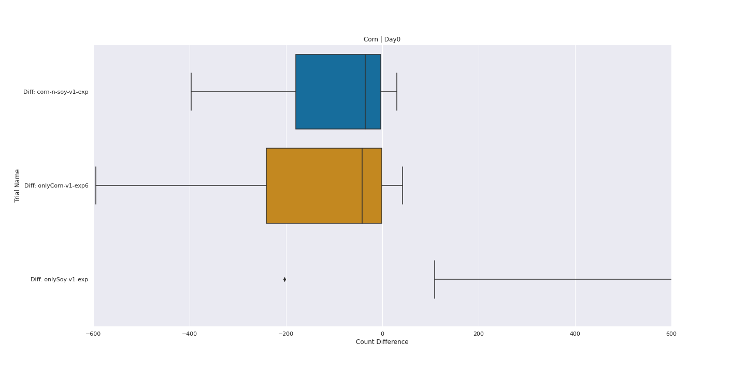
Mean Count Difference close to 0 Corn and Soy Model Performs the best

Slide 19
CORN – DAY5 - Overall

Slide 20
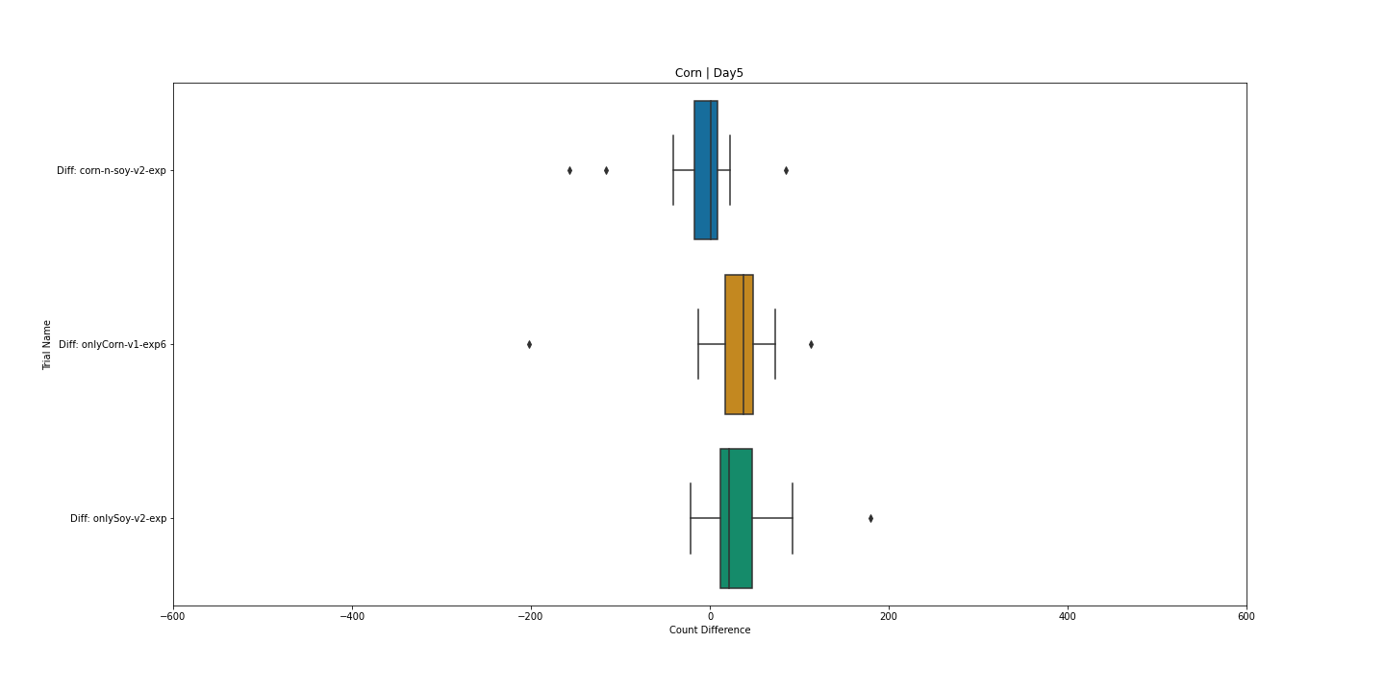
Corn and Soy Model Performs the best
Day 5 detection is more accurate

Slide 21
SOY – DAY0 - Overall

Slide 22
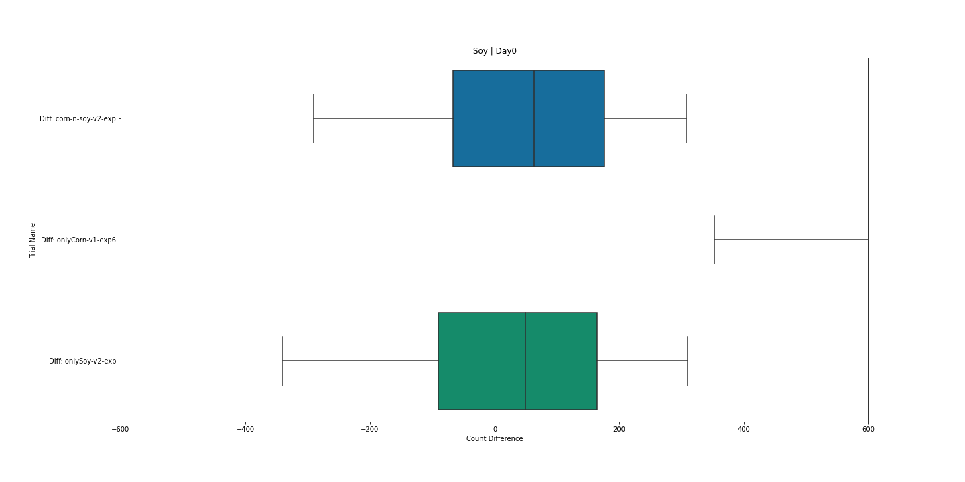
Mean Count Difference close to 0 Corn and Soy Model Performs the best
Higher count difference compared to corn

Slide 23
CORN – DAY0 – GROWTH STAGE

Slide 24
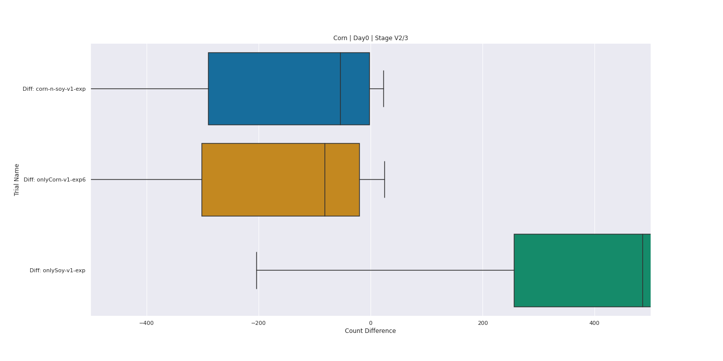
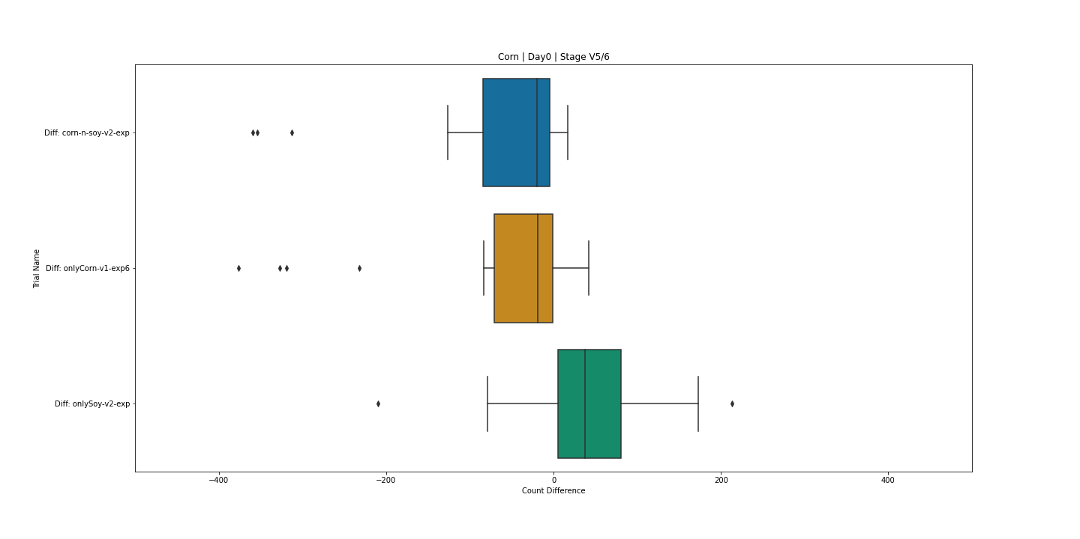
Less error in later crop growth stage
CORN V2/3
CORN V5/6

Slide 25
SOY – DAY0 – GROWTH STAGE

Slide 26
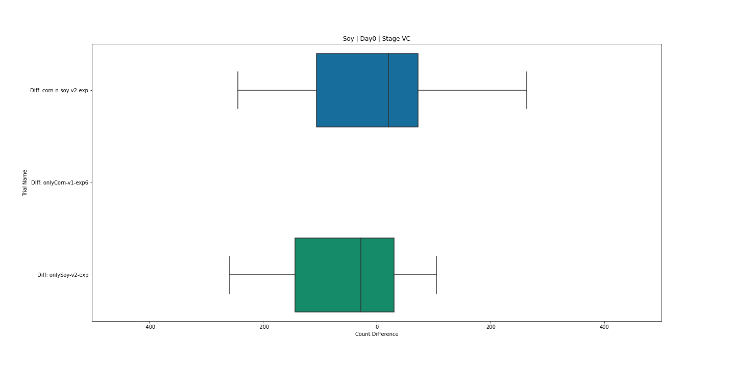
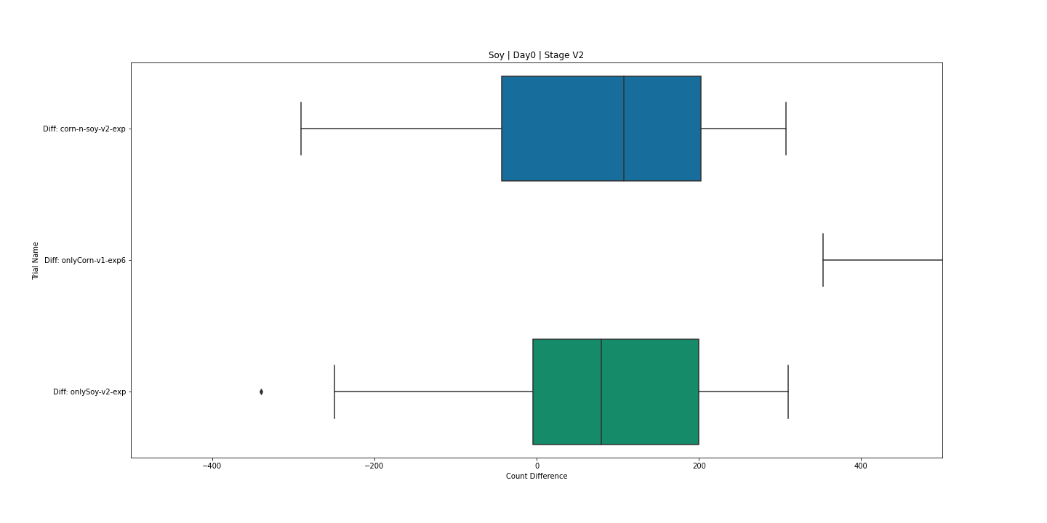
Less error in Early Soy growth Stage
SOY VC
SOY V2

Slide 27
Thank You
Varun Aggarwal
aggarw82@purdue.edu

Slide 28
CORN – DAY0 - SIZE

Slide 29
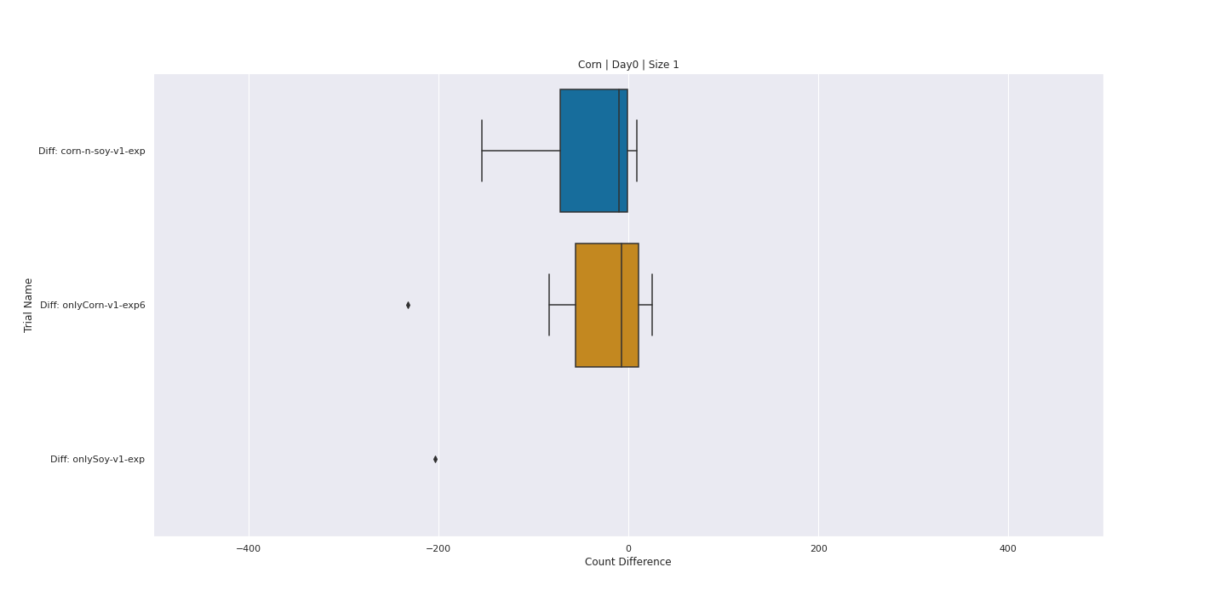
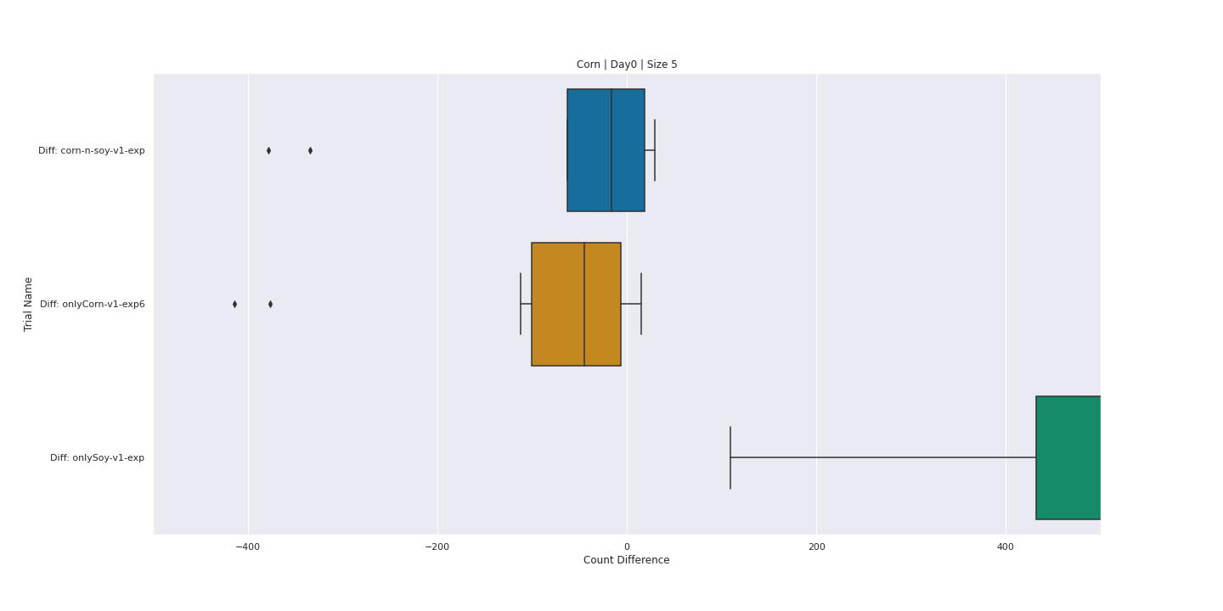
Corn and Soy Model Performs the best
Detects Size 1 and Size 5 will similar performance
Corn Size 1
Corn Size 5

Slide 30
SOY – DAY0 - SIZE

Slide 31
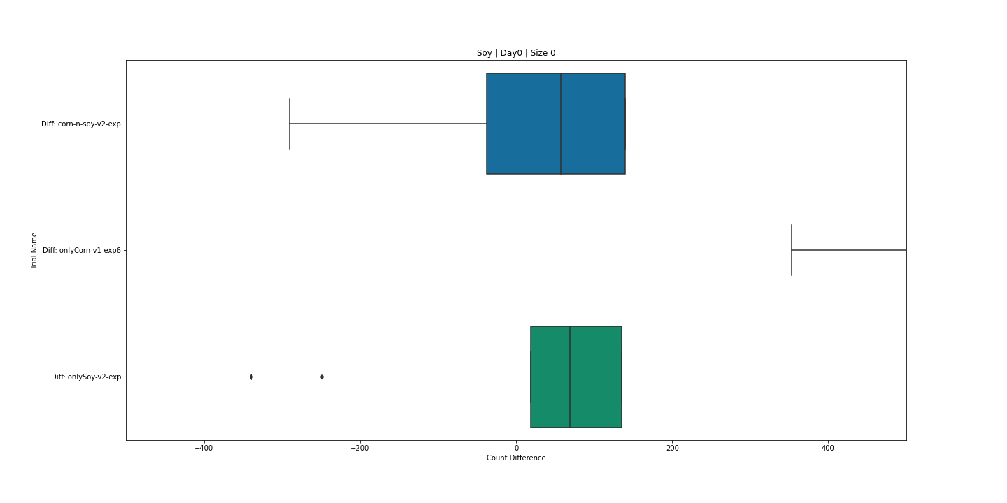
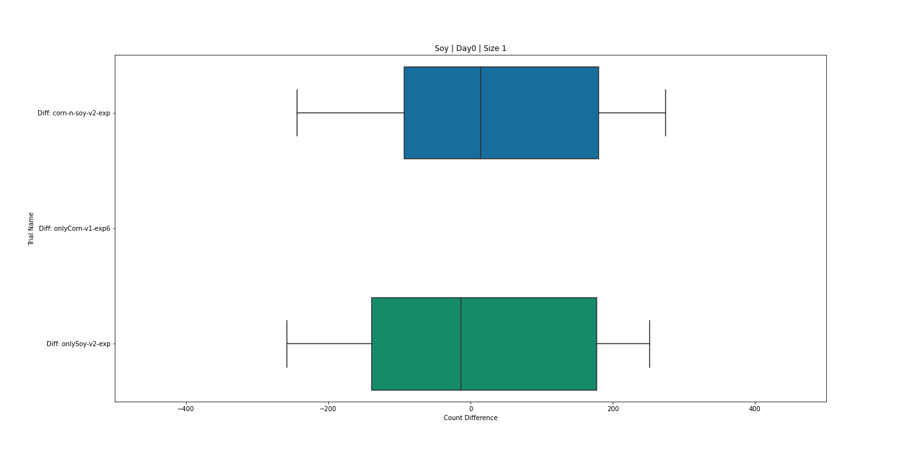
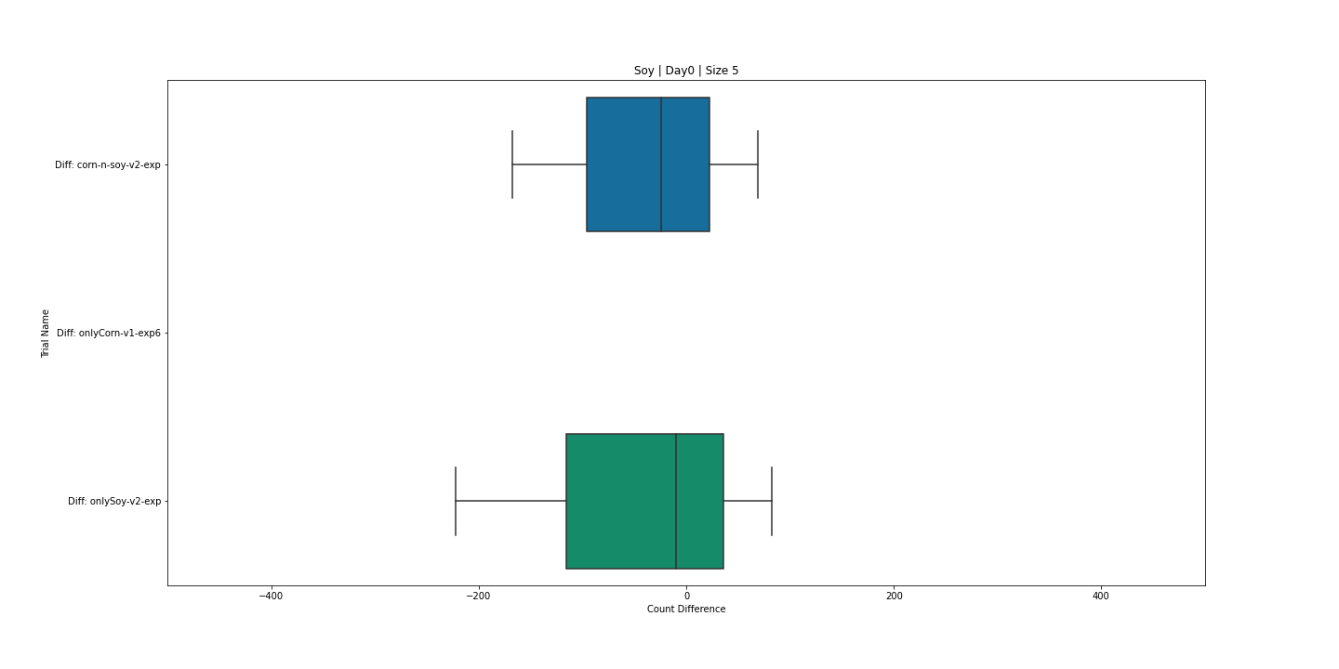
Less error in plots with Size 0 and 5 weeds
Soy Size 0
Soy Size 1
Soy Size 5

Slide 32
Extra Slides

Slide 33
Objectives
Develop a Model to detect weeds in corn and soybean field
Count number of weeds
Verify against Manual Count
Localize the weeds in the field to identify high weed density areas

Slide 34
Plot Number | Treatment | Corn Stage | Size | Manual Count | Number of Training Images | Number of Weeds
101 | 1 | V2/3 | 1 | 176 | 87 | 118
102 | 6 | V5/6 | 5 | 95 | 43 | 54
103 | 3 | V2/3 |  | 627 | 72 | 96
104 | 4 | V2/3 |  | 444 | 9 | 15
105 | 2 | V2/3 | 1 | 1359 | 202 | 1911
106 | 1 | V2/3 | 5 | 838 | 5 | 5
107 | 4 | V2/3 |  | 642 | 2 | 2
204 | 8 | V5/6 |  | 383 | 4 | 4
205 | 7 | V5/6 |  | 431 | 1 | 1
206 | 12 | V5/6 |  | 341 | 13 | 15
208 | 4 | V2/3 |  | 52 | 2 | 2
209 | 5 | V5/6 | 1 | 88 | 14 | 17
210 | 2 | V2/3 | 5 | 419 | 2 | 2
211 | 3 | V2/3 |  | 314 | 3 | 4

Slide 35
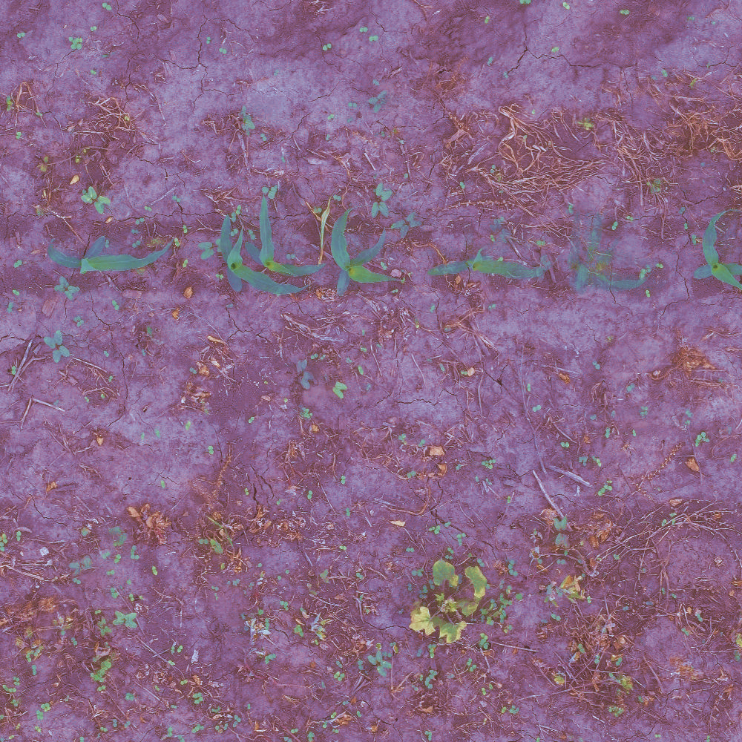
Original
Enhanced

Slide 36
TRAINING DATA STATS SOY

Slide 37
Plot Number | Treatment | Soy Stage | Size | Manual Count | Number of Training Images | Number of Weeds
301 | 10 | V2 | 0 | 894 | 530 | 1689
308 | 8 | V2 |  | 187 | 66 | 87

Slide 38
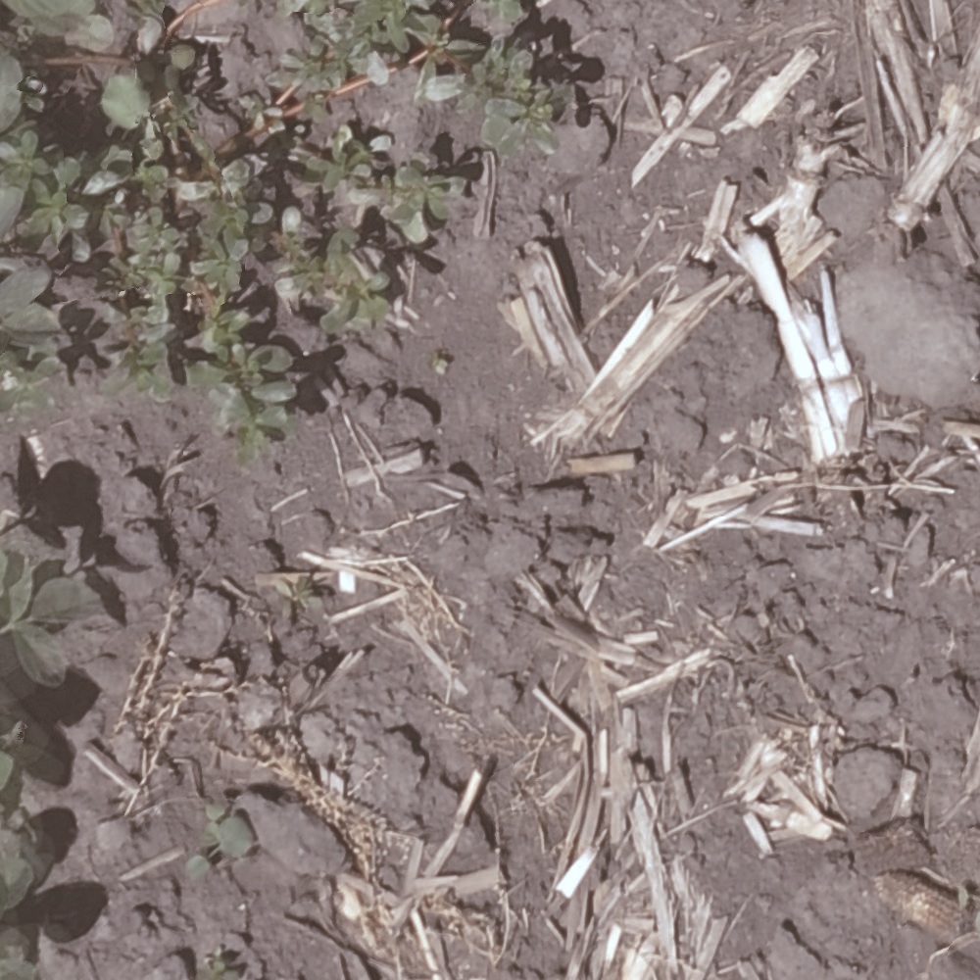
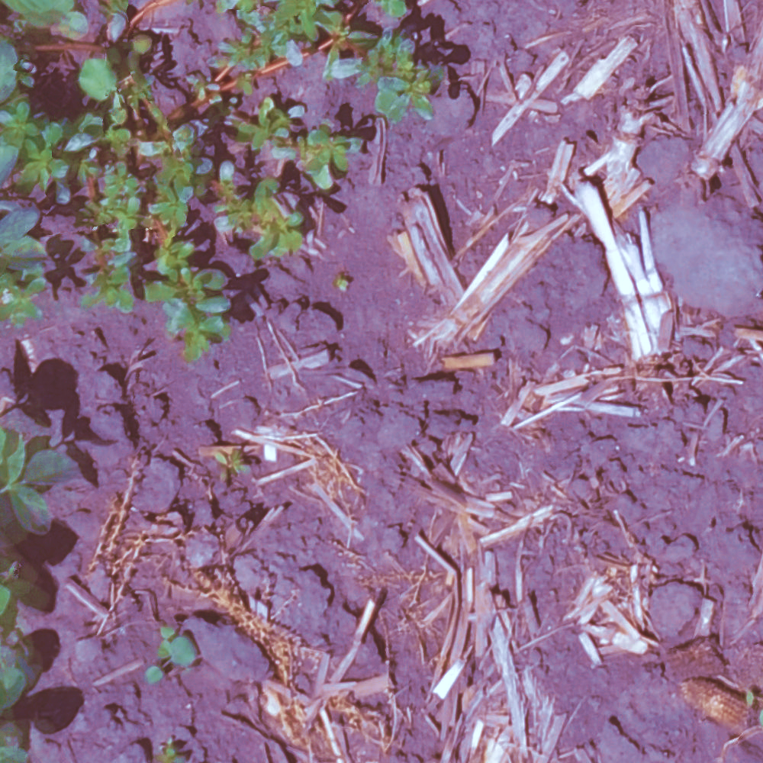
Original
Enhanced

Slide 39
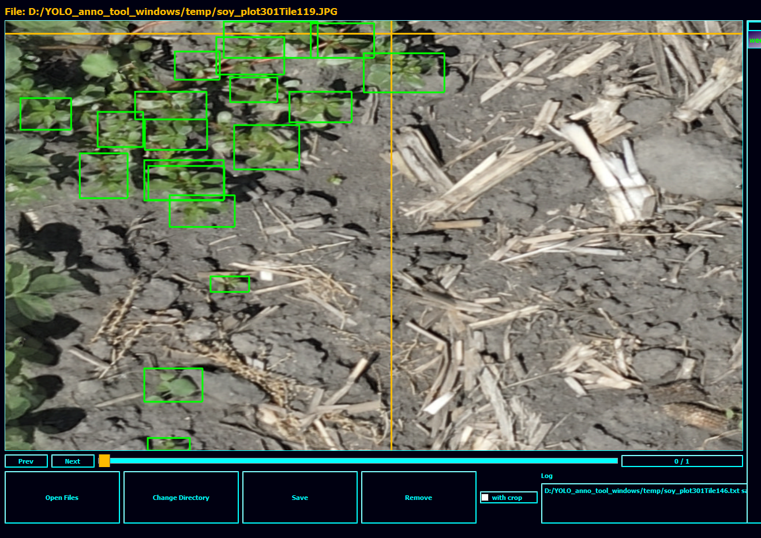
19 Weed instances

